Slide 1
Improving RL Agent for Dilution
(Part 5 – Closer Look at Data)
May 18

Slide 2
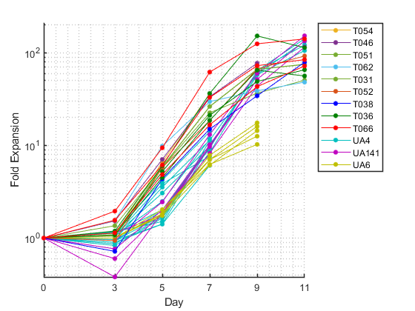
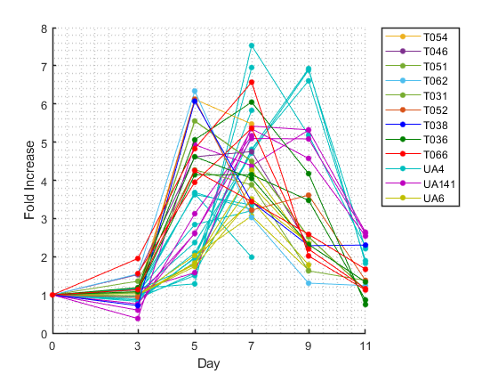
12 Treg Donor Data Visualized (Part 2)
Fold expansion (cell concentration)
Fold increase factor

Slide 3
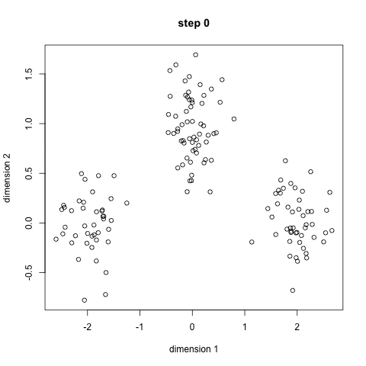
Clustering
Identify groups of data (in our case: donors) that share similar characteristics
K-means clustering (left)
  Initialize centroids
  Calculate distance to nearest centroid
  Calculate new centroid location
  Iterate
DBSCAN
EM GMM
https://towardsdatascience.com/the-5-clustering-algorithms-data-scientists-need-to-know-a36d136ef68

Slide 4
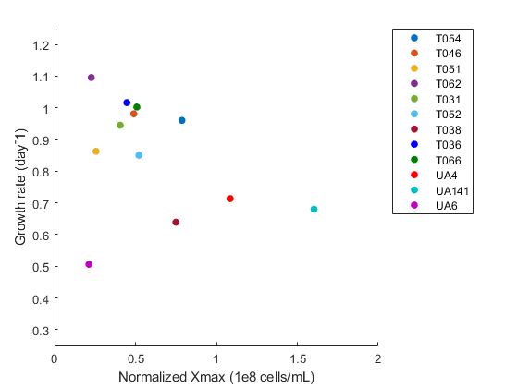
Input data: logistic model parameters
Normalized Xmax
Normalized Growth rate

Slide 5
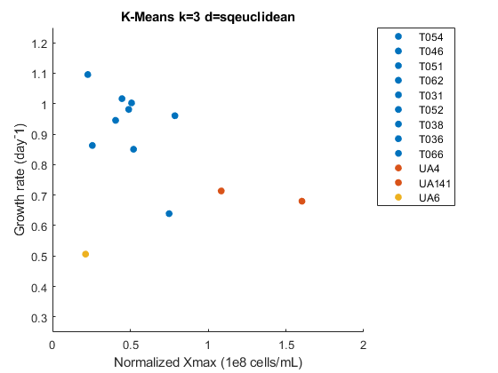
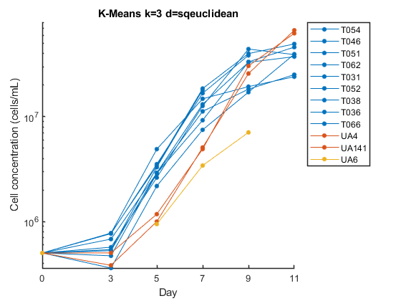
K-means k=3
1
1
1
1
1
1
1
1
1
2
2
3

Slide 6
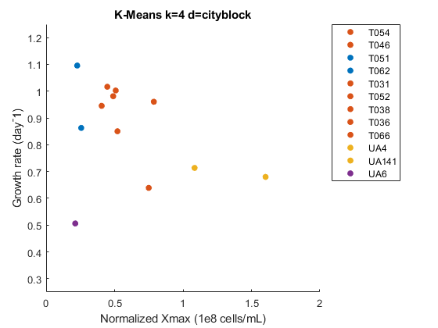
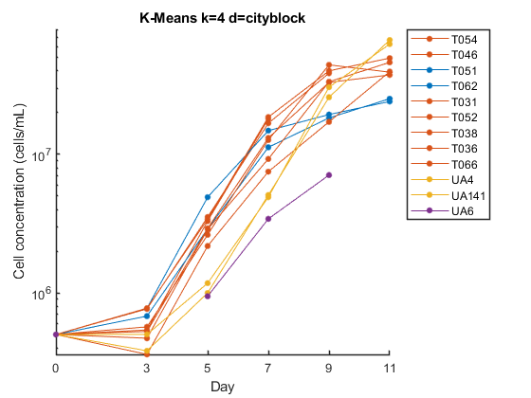
K-means k=4
2
2
1
1
2
2
2
2
2
3
3
4

Slide 7
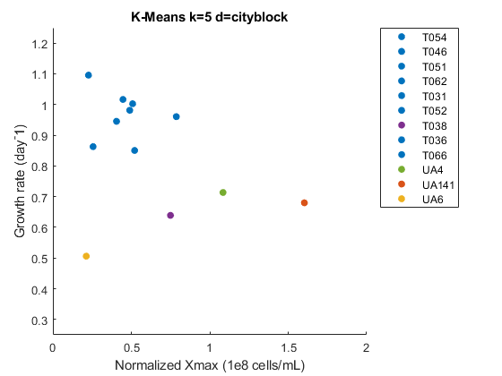
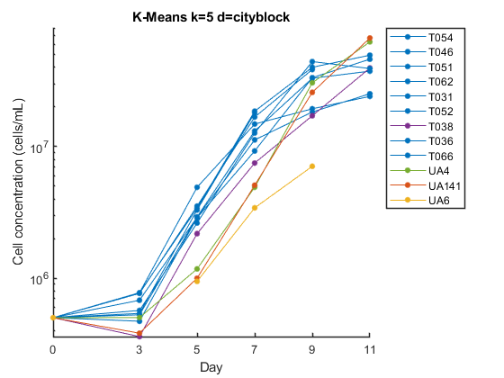
K-means k=5
1
1
1
1
1
1
4
1
1
5
2
3

Slide 8
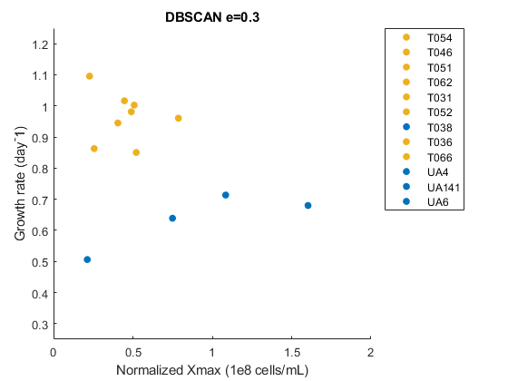
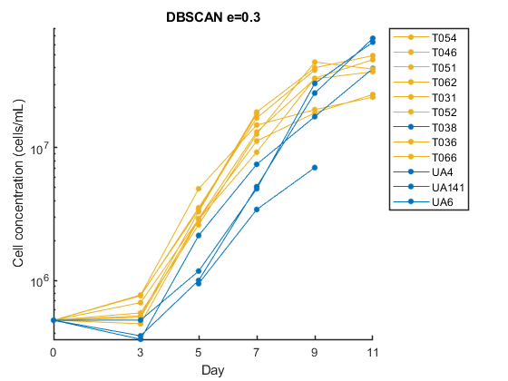
DBSCAN
3
3
3
3
3
3
1
3
3
1
1
1

Slide 9
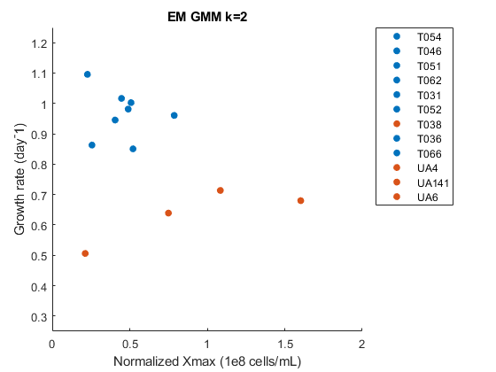
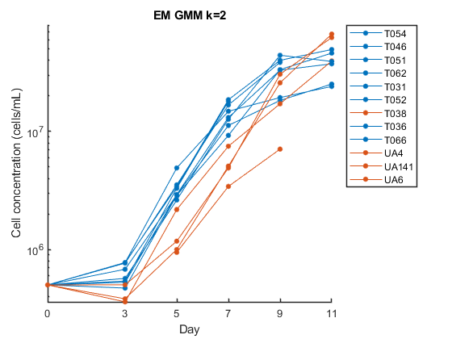
EM GMM k=2
1
1
1
1
1
1
2
1
1
2
2
2

Slide 10
Now we have an idea of what donor clusters exist in our data set
Problem: cannot predict donor cluster of new donor without data all the day up to day 11

Slide 11
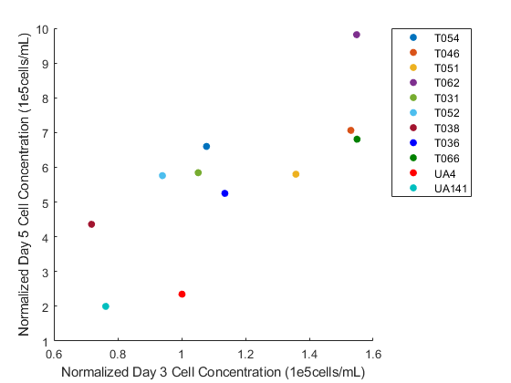
Input data: day 3 and day 5 data
Normalized day 3 cell concentration
Normalized day 5 cell concentration

Slide 12
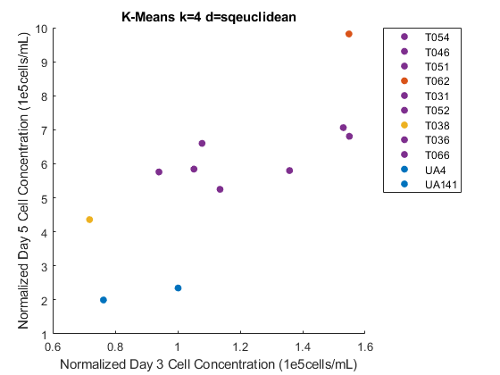
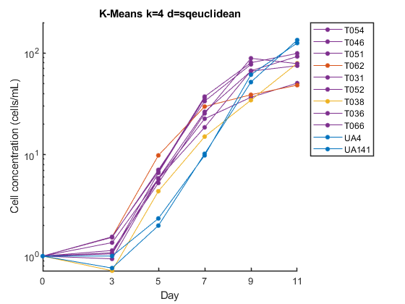
K-means k=4
4
4
4
2
4
4
3
4
4
1
1
2

Slide 13
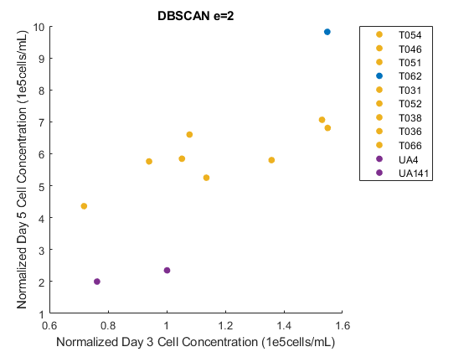
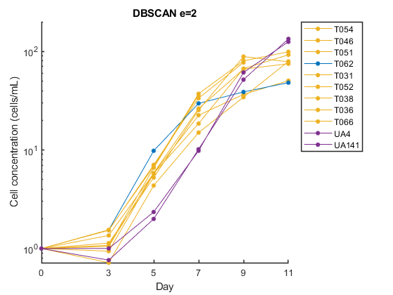
DBSCAN
3
3
3
1
3
3
3
3
3
4
4
2

Slide 14
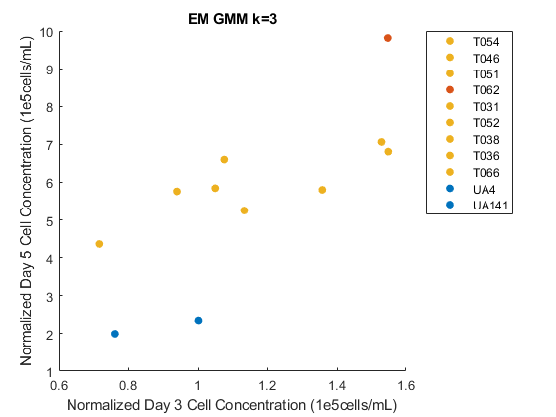
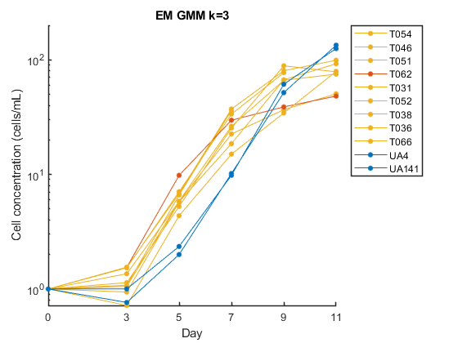
EM GMM k=3
3
3
3
2
3
3
3
3
3
1
1
2

Slide 15
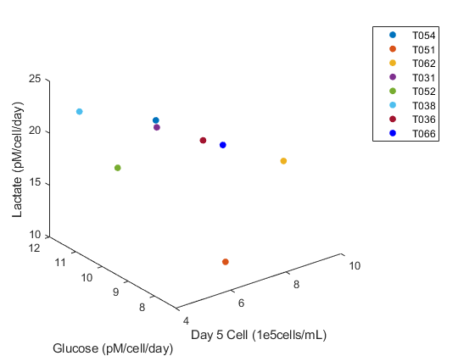
Input data: day 3 and day 5 data
Normalized day 3 cell concentration (not shown)
Normalized day 5 cell concentration
Day 3-5 Glucose uptake rate
Day 3-5 Lactate production rate

Slide 16
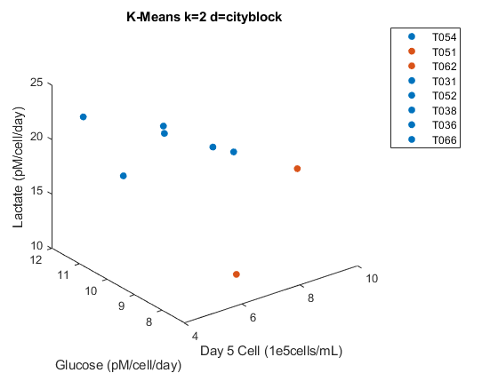
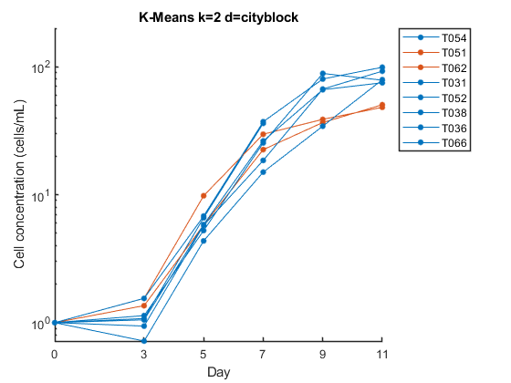
K=means k=2
1
2
2
1
1
1
1
1

Slide 17
Can the results help me select training vs validation sets for the RL environment?
Can the donors of one cluster share a logistic model?

Slide 18
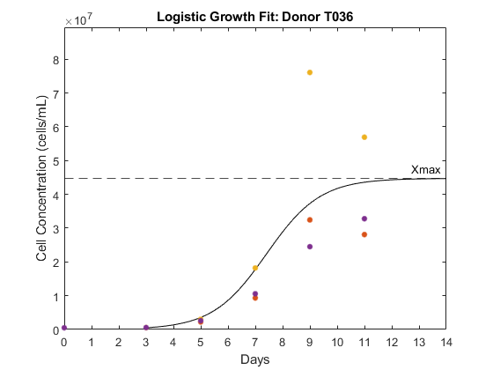
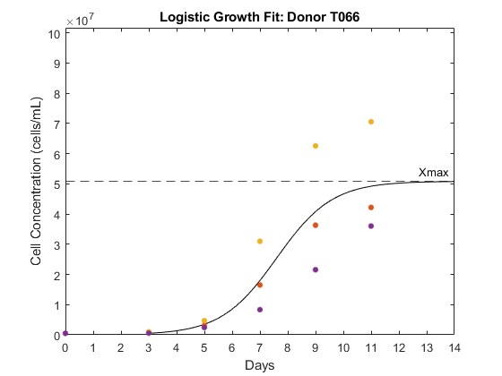
Back to Reinforcement Learning
New environment changes
  Day 0 included
  Experiment stop threshold
Observations from testing different training sets.
Including donors UA4 and UA141 in the training set increases the total reward during validation.
Including donor UA6 in the training set decreases the total reward during validation.
T036 and T066 has extreme outliers (regardless of training set selection)
Agent is not making correct decision for UA4 and UA141, despite being trained on UA4 and UA141.

Slide 19
UA4 and UA141 not working
Separate??

Slide 20
Hypotheses during Troubleshooting
Epsilon greedy decay rate needs to be scaled as the number of training increases, so the agents has more episodes to explore the bigger environment. Tested: Correct, total reward went from 9.3 to 20.94
The stop experiment penalty is too harsh. Agents starts to take the dilution penalty to avoid the stop experiment penalty. Tested: Correct.
Something wrong with data set for UA4 and UA141. Same data set used.
There is too much variation in the environment so the observations (cell concentration and time) and neural network is not able to capture the variability.
  DQN algorithm: the agent is drawing on a buffer with experiences that may be too dissimilar.
  Try including average growth rate into the observation?

Slide 21
Training vs validation of the U donors – plot and see the discrepancy

